Slide 1
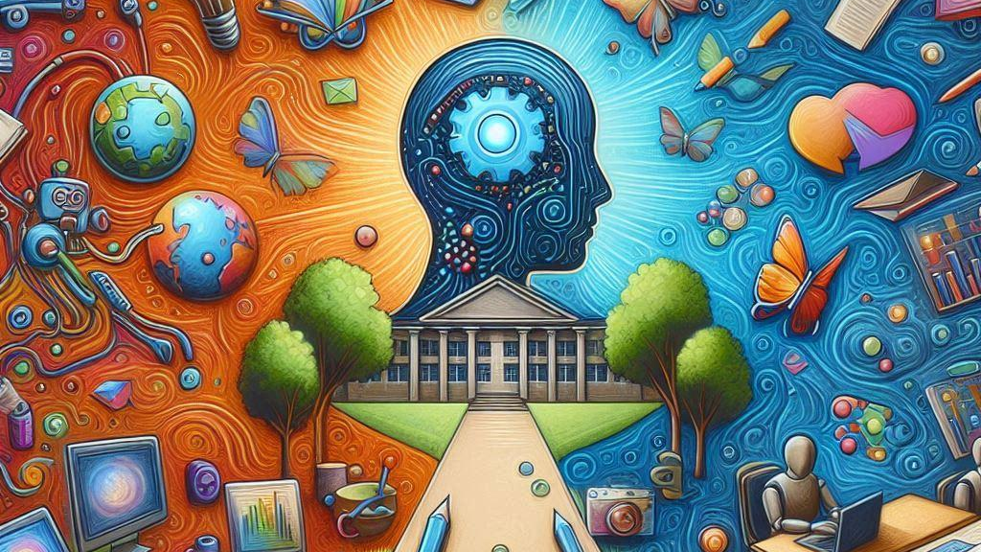
AI Usage by Students for Creativity
by Sadman Sakib Khan Promit

Slide 2
Introduction
AI has been a hot topic for the last two years.
With the introduction of Chatgpt, AI has integrated unconsciously into our daily lives.
Generative AI applications for creating content are the most popular AI applications.

Slide 3
Introduction
Generative in this context means generating texts, pictures, and videos.
But generation doesn’t mean creation but mixing and matching other people’s works!
But they somewhat hurt students’ creative capabilities.
Too much automation is making the machines lively and us the robots.

Slide 4
Research Questions
Why and how do students use AI?
Are students depending more on AI than learning nowadays?
Are AI applications and the services they provide for students trustworthy?
Is AI helping students learn creative thinking or harming their creative capabilities?
If a student uses AI for homework, do you think it is cheating?

Slide 5
Research Questions
What do you think about AI generating copyrighted content?
To what extent can AI-generated content be modified to become acceptable?
Do you think AI and professionals should be equally paid?
Do you prefer AI or professionals to do your creative tasks?
Would you co-author an AI tool if you take its assistance?
What legal laws should you introduce for all these controversies related to AI plagiarism?

Slide 6
Hypothesis & Expectations
AI hurts students’ creative capabilities.
AI is the most controversial topic today, especially among academics.
It is like the new calculator, which is helpful, but we must remember basic arithmetic.
Various ethical and legal controversies arise from AI usage.
Among them, creative capabilities strike the most.
These so-called mechanical brains are performing creativity at the best human level.
But are we ready for such advancements?

Slide 7
Hypothesis & Expectations
AI hurts students’ creative capabilities.
Nowadays, students get AI aid and complete their assignments without looking at the AI-generated work.
One cannot argue against its hurting of creative capabilities.
Students are depriving themselves of actual learning by using it to cheat and plagiarize.

Slide 8
Hypothesis & Expectations
AI hurts students’ creative capabilities.
AI detectors cannot detect all the AI generations. Sometimes, students spend a colossal time finding these vulnerabilities rather than studying.
Those times should have been utilized in education, not in immoral ways.

Slide 9
1st Literature Review
Fore (2023) argues that AI might help accessibility to education, but it promotes cheating and plagiarism.

Slide 10
2nd Literature Review
Habib et al. (2024) explore the roles of AI in creative thinking. They depict how it negatively impacts students' creativity and suggest a careful approach.

Slide 11
3rd Literature Review
Marrone et al. (2022) researched how AI can be integrated into classrooms. It qualitatively analyzed how AI and creativity correlate. They argued that AI can never reach human creative levels.

Slide 12
4th Literature Review
Marshall (2023) discusses how the threshold between AI and human-created content is diminishing daily. He illustrates how AI and AI detectors are at war and why human creativity is becoming shallower daily.

Slide 13
5th Literature Review
According to Singer (2023), statistics show that AI didn’t increase cheating in high schools.

Slide 14
6th Literature Review
Vaidhyanathan (2023) found that students are cheating using AI. She portrays how AI can bring havoc to our lives.

Slide 15
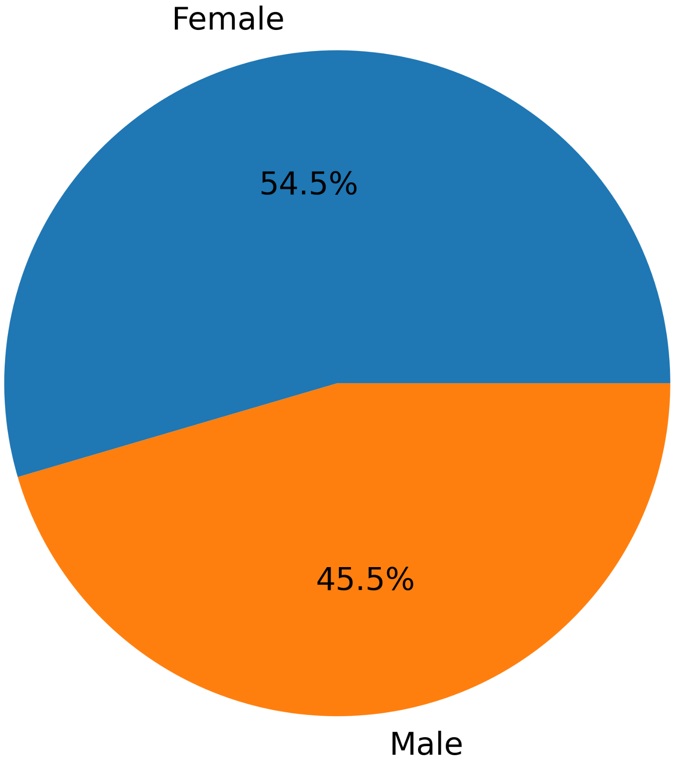
Primary Research Results
______
Participants Statistics:
22 Students
20 from NSU
1 from BUBT
1 from JU
12 females
10 males
Other 0%
_____

Slide 16
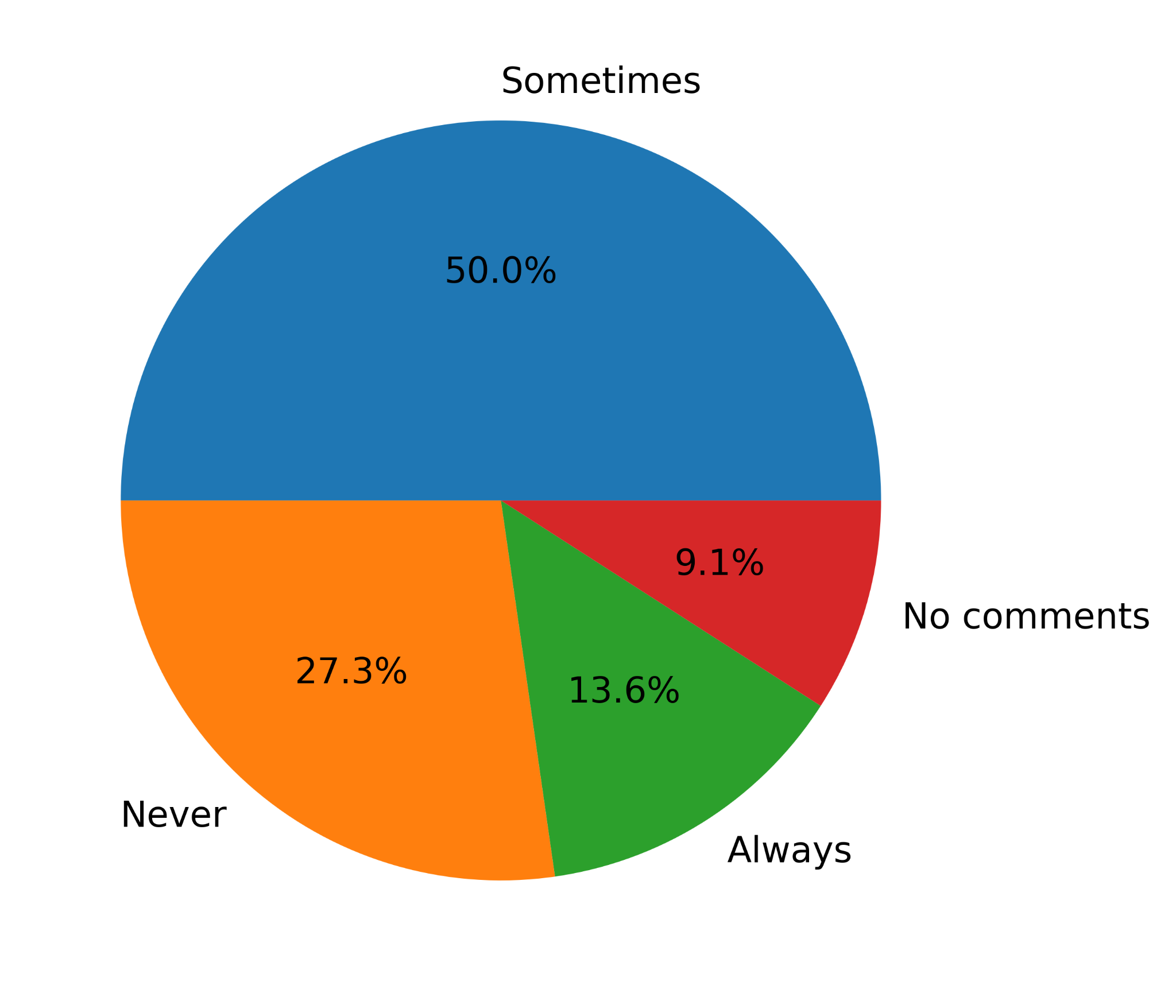
1st Question Close-ended
Have you ever plagiarized homework by using AI and got away with it?
________
_________
____
_____

Slide 17
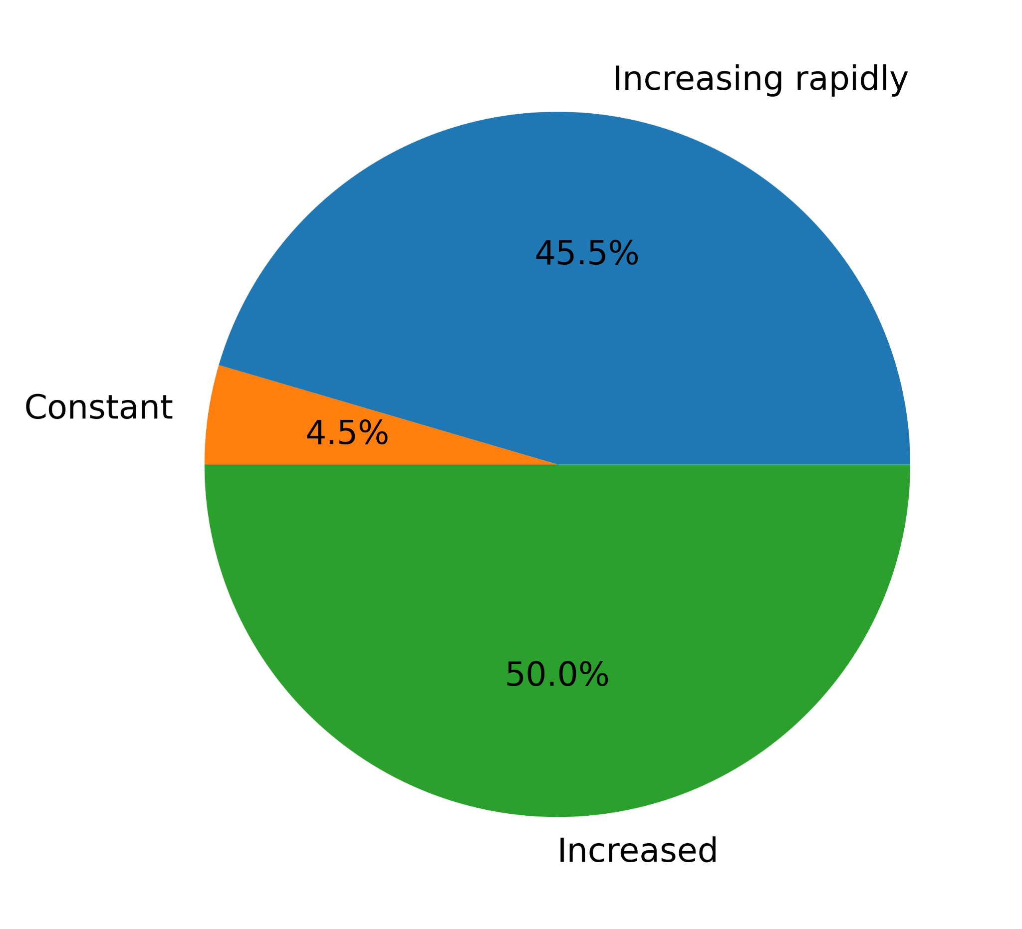
2nd Question Close-ended
Has overall student plagiarism increased after AI came?
Decreased 0%
Decreasing rapidly 0%
_____________
_______
________

Slide 18
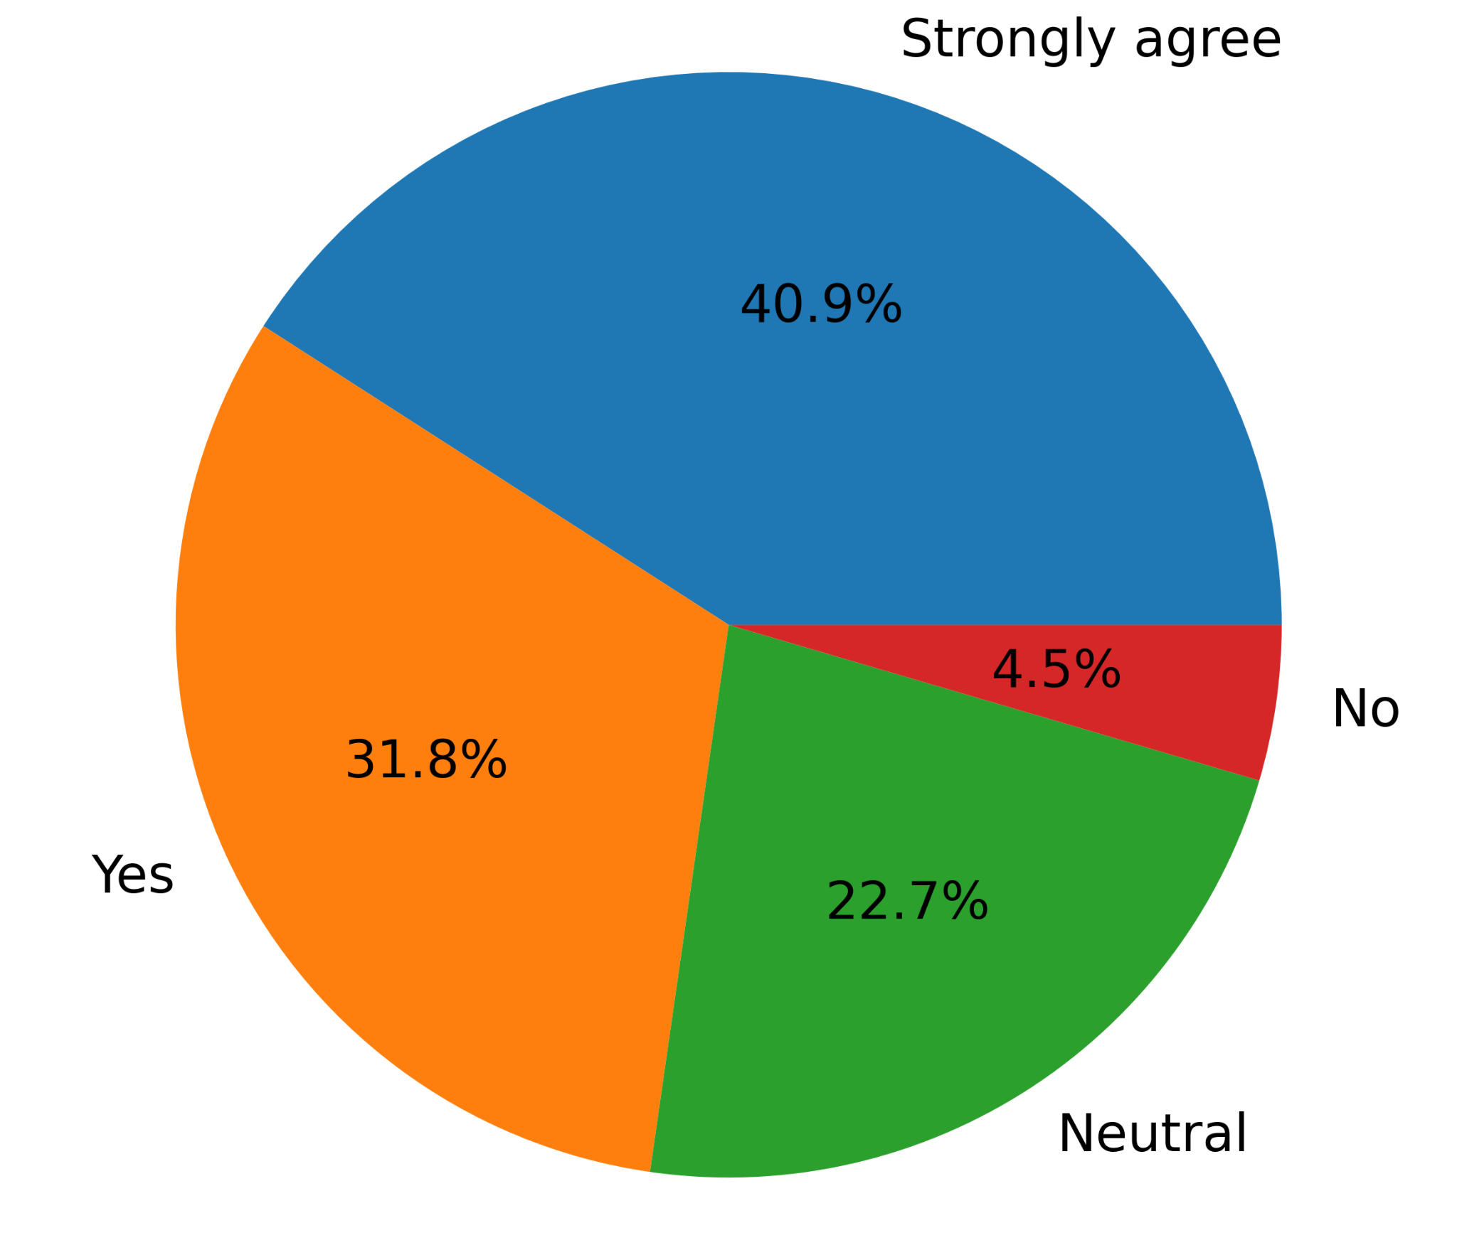
3rd Question Close-ended
Do you agree that AI hurts students’ creative capabilities?
Strongly disagree 0%
____________
___
___
______

Slide 19
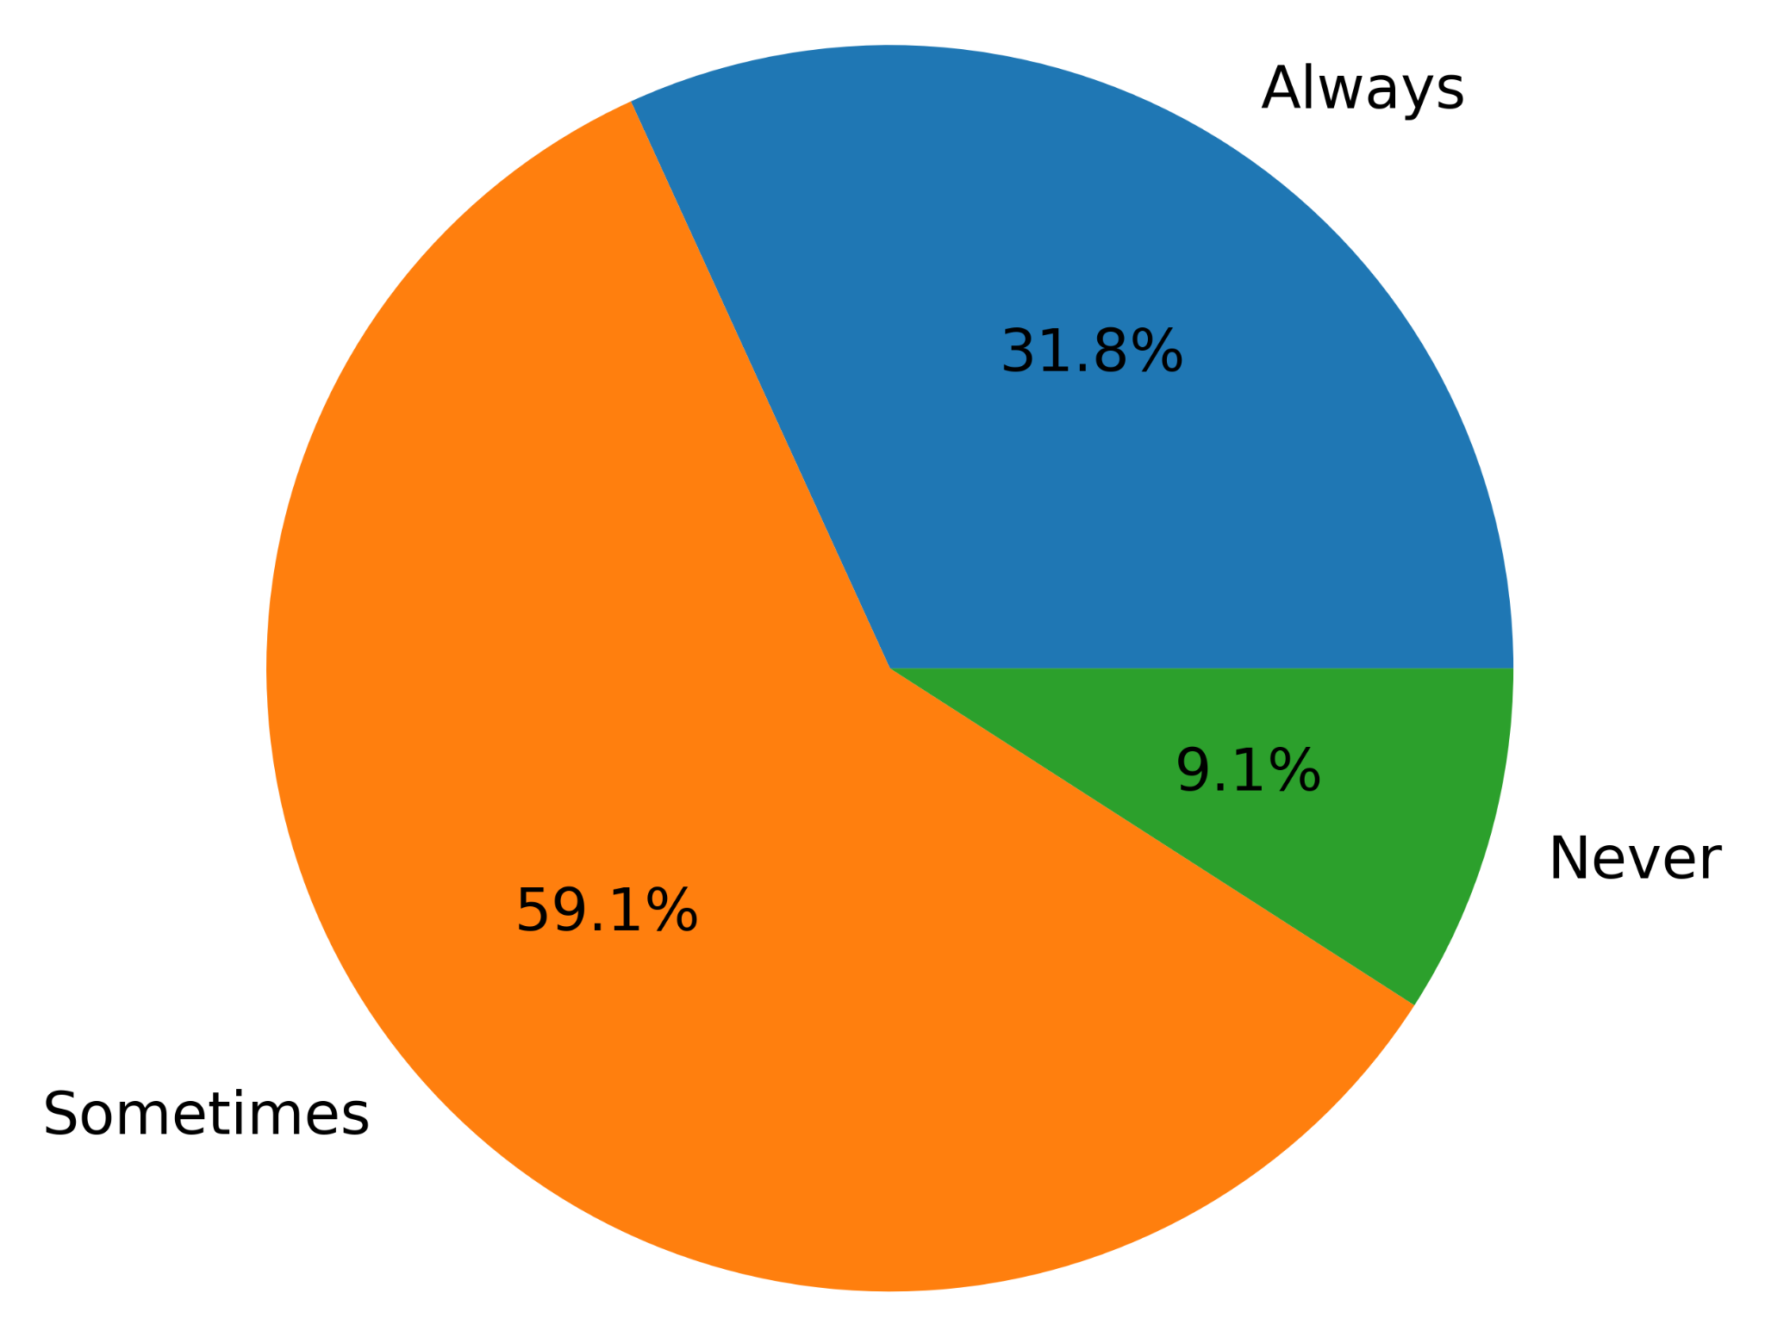
4th Question Close-ended
Can students increase their creativity by utilizing AI somehow?
No comments 0%
______
_____
_________

Slide 20
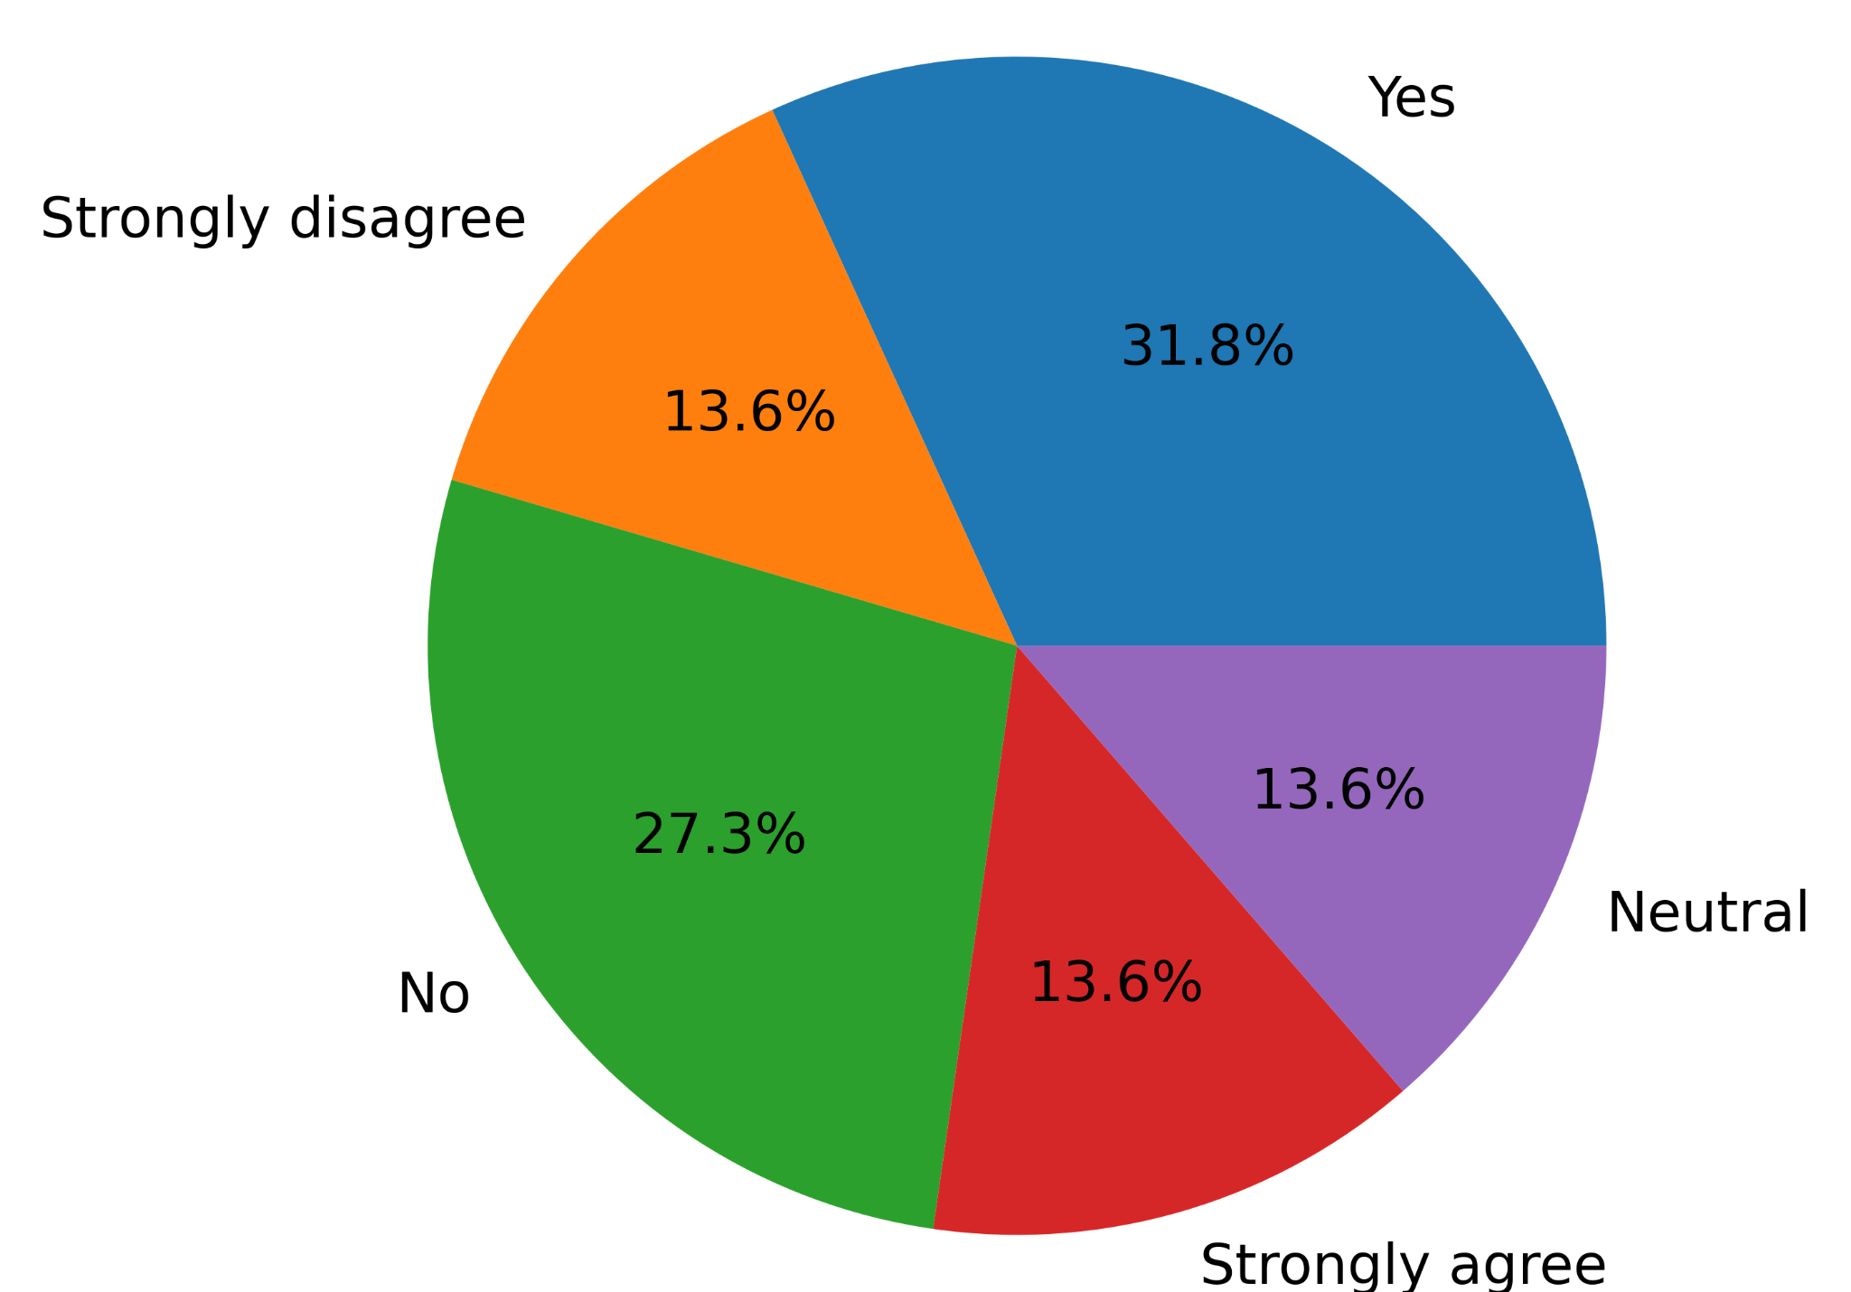
5th Question Close-ended
Do you agree that additional class tests should replace homework?
___
_____________
______
__
___________

Slide 21
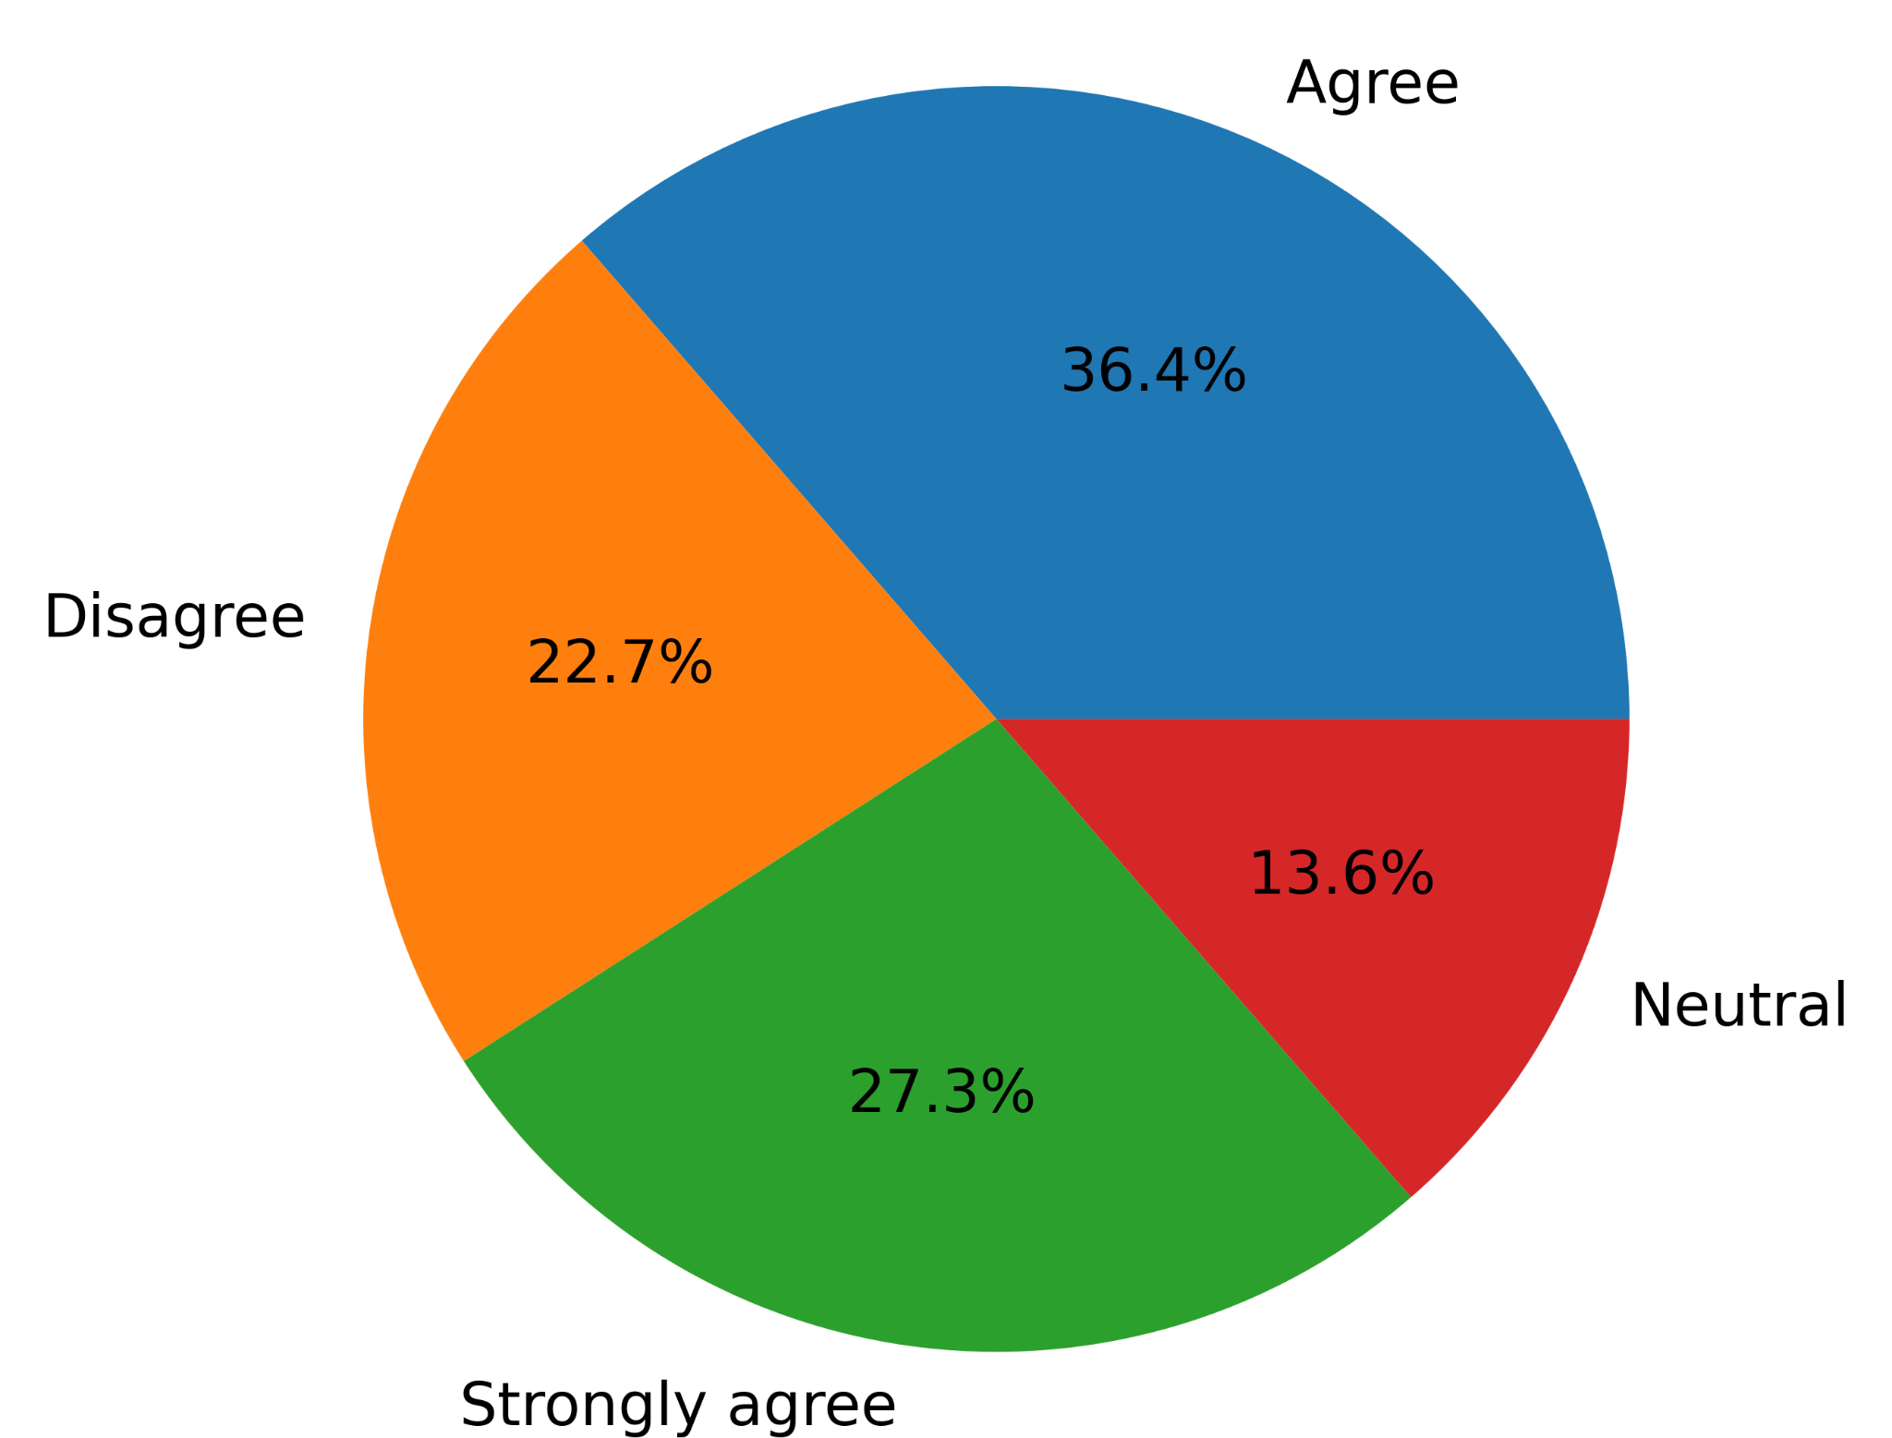
6th Question Close-ended
Do you agree that students’ homework should become classwork to avoid AI plagiarism?
Strongly disagree 0%
_____
_______
______
__________

Slide 22
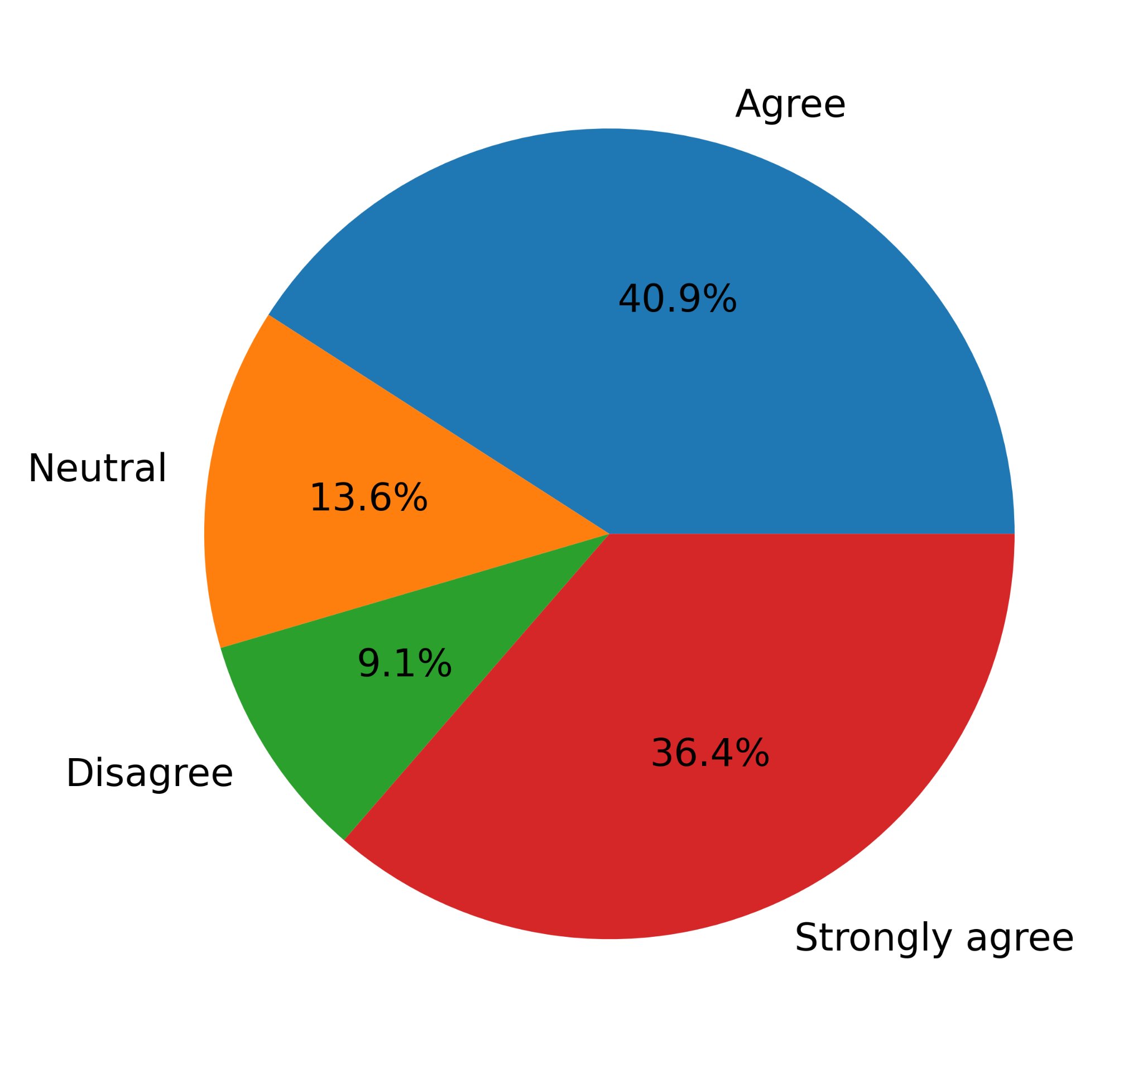
7th Question Close-ended
Do you agree that universities should teach ethics related to AI usage?
Strongly disagree 0%
____
______
_______
__________

Slide 23
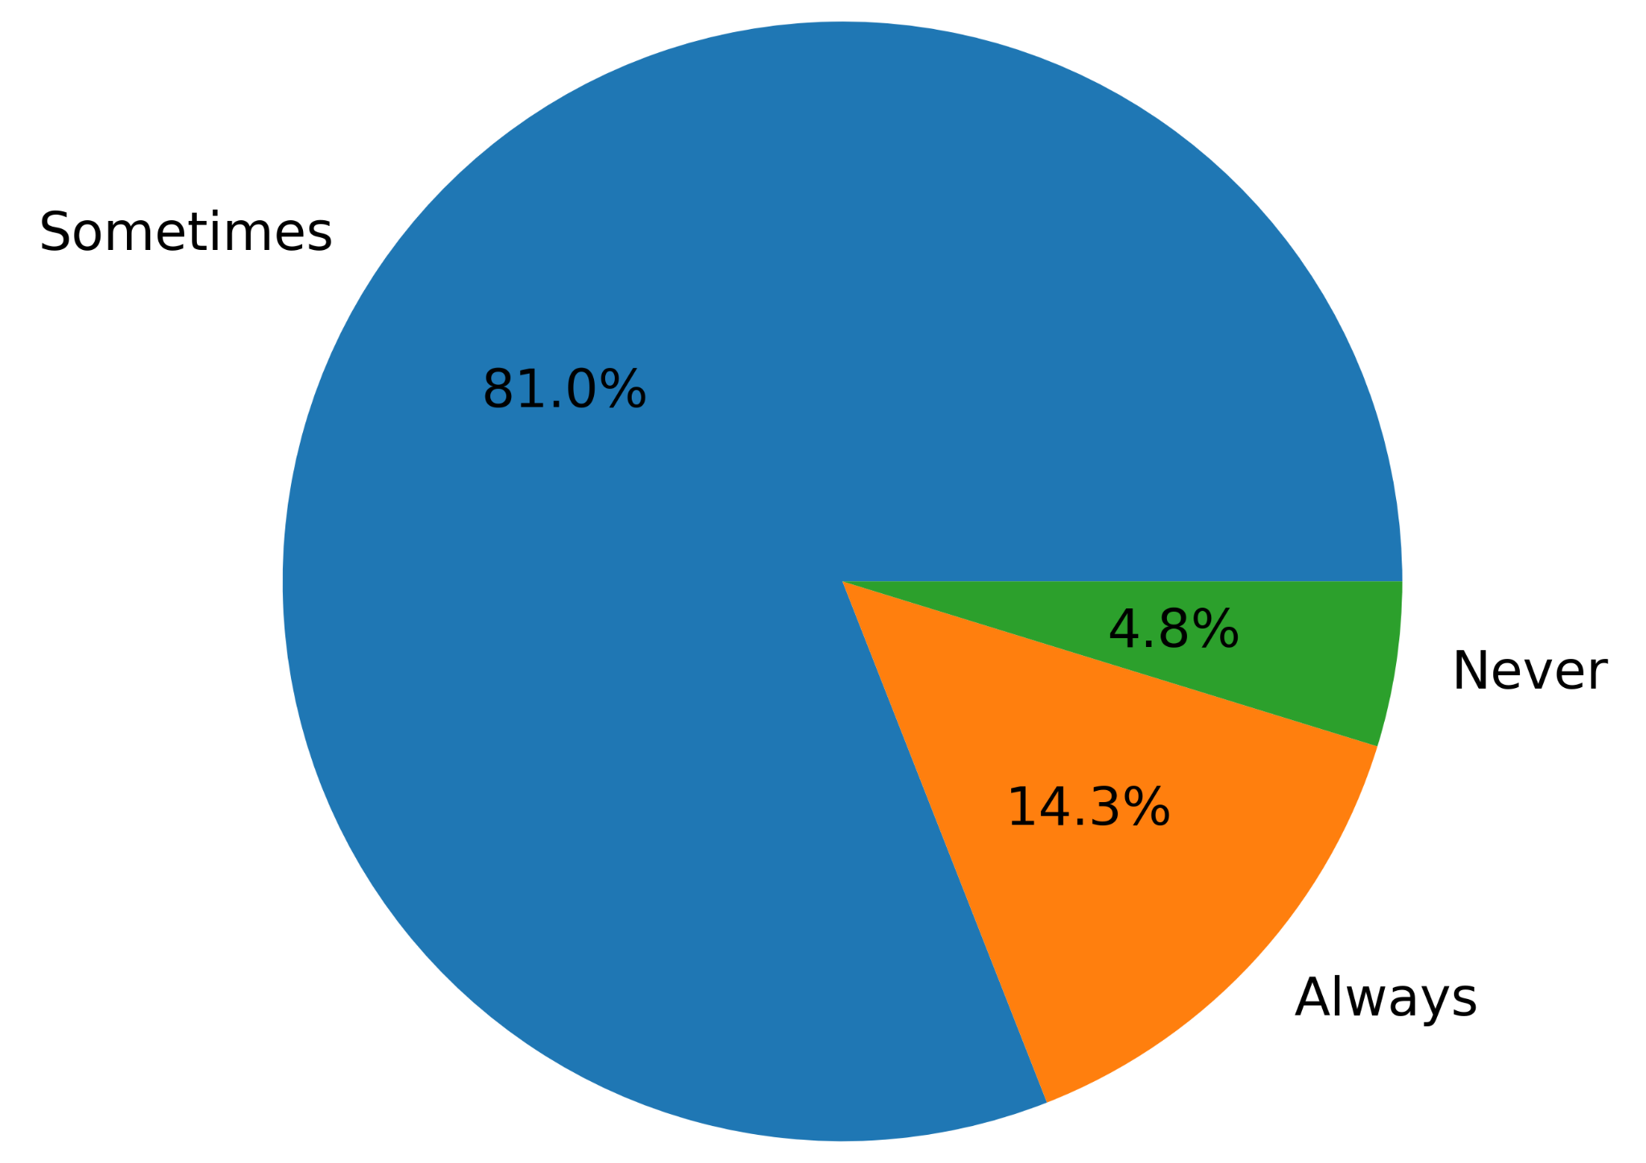
8th Question Close-ended
Should students use AI at all?
No comments 0%
__________
______
_______

Slide 24
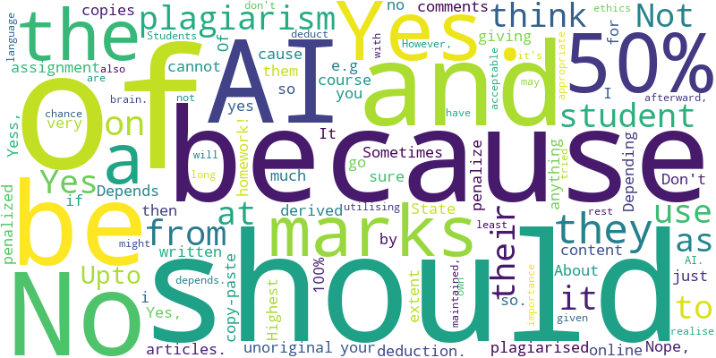
1st Question Open-ended
Do you think it is appropriate to penalize students for AI plagiarism? If so, then please mention to what extent and why.

Slide 25
1st Question Open-ended
Do you think it is appropriate to penalize students for AI plagiarism? If so, then please mention to what extent and why.
“Yes. Upto 50% of plagiarised assignment for unoriginal content derived from written articles.”
“No”
“Depends”
“No”
“Yes. It should cause marks deduction.”

Slide 26
1st Question Open-ended
Do you think it is appropriate to penalize students for AI plagiarism? If so, then please mention to what extent and why.
“Depending on the extent of plagiarism e.g if a student copies 100% from AI then penalize them by giving no marks and so on”
“Of course they should be”
“Not sure About anything”
“Not very much”
“yes because you cannot go online and just copy-paste your homework!”

Slide 27
1st Question Open-ended
Do you think it is appropriate to penalize students for AI plagiarism? If so, then please mention to what extent and why.
“Nope, i Don't think so.”
“Sometimes”
“Yes”
“No comments”
“Yess, I think student should be penalized at a Highest State”
“Yes”
“No”

Slide 28
1st Question Open-ended
Do you think it is appropriate to penalize students for AI plagiarism? If so, then please mention to what extent and why.
“Yes, because afterward, they will have a chance to realise the importance of utilising their brain. However, it might be acceptable to use AI as long as AI ethics are maintained, and it may also depends.”
“it's should deduct 50% marks because of plagiarism and rest of the 50% should be given because they at least tried with AI.”
“not appropriate”
“Yes. Students don't use their own language because of AI”

Slide 29
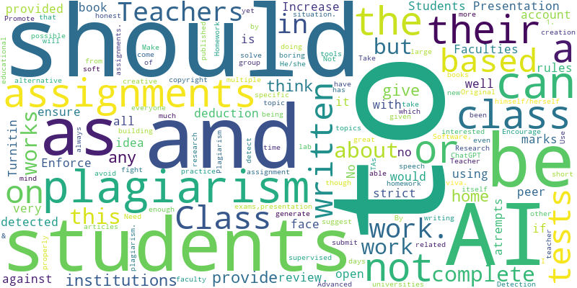
2nd Question Open-ended
Please suggest some good rules to fight AI plagiarism in universities.

Slide 30
2nd Question Open-ended
Please suggest some good rules to fight AI plagiarism in universities.
“Presentation based on all written assignments and peer review.
“No idea”
“Class tests”
“Teachers as well as students should be provided with Turnitin account”
“Students would face marks deduction if AI plagiarism is detected in their work.”

Slide 31
2nd Question Open-ended
Please suggest some good rules to fight AI plagiarism in universities.
“Class practice”
“Need creation AI plagiarism tools”
“Make the students interested about their given topics and building a mind of doing research related to that specific topic”
“By generate new AI soft which can detect AI plagiarism”
“Take more class works and group works”
“Teachers should not suggest ChatGPT in class & students should avoid this as much as possible”

Slide 32
2nd Question Open-ended
Please suggest some good rules to fight AI plagiarism in universities.
“1. He/she should always be honest to himself/herself”
“Teacher should not give a large home work. Homework should be short and based on everyone written home work teacher can take viva.”
“Not being able to copyright from books or articles even though the writing itself has been published”
“Encourage faculty to not give boring assignments.”
“Use Advanced Plagiarism Detection Software, Promote Original Research”

Slide 33
2nd Question Open-ended
Please suggest some good rules to fight AI plagiarism in universities.
“Faculties should be very strict about this and should ensure no students atrempts it”
“Increase open book exams,presentation speech and lab work”
“Enforce rules against complete plagiarism using AI”

Slide 34
2nd Question Open-ended
Please suggest some good rules to fight AI plagiarism in universities.
“class tests can be a great alternative to fight AI plagiarism. but yet homework or assignments provide enough time to think properly to solve any situation. I think universities or other educational institutions can provide multiple days to submit any creative assignment but students will have to come to their institutions to complete the assignments supervised by TAs”

Slide 35
Conclusion
Final findings:
Students are only using AI for plagiarism.
Both primary and secondary research results imply negativity.
They consider it unethical to penalize students, considering current education systems lack AI supervision.
Therefore, the hypothesis that AI hurts students’ creative capabilities is true.

Slide 36
Conclusion
Final comments:
AI should be used as additional study material.
With the help of AI, more work can be done.
The total work will be the same no matter what tools people use.

Slide 37
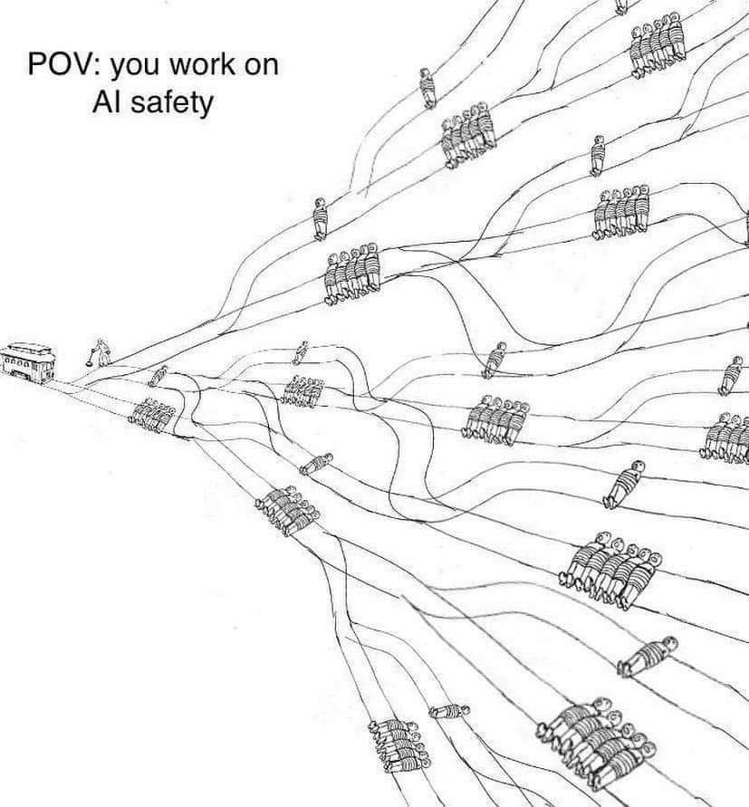
Thank You! 😄

